Slide 1

Inflation and
real estate

Slide 2
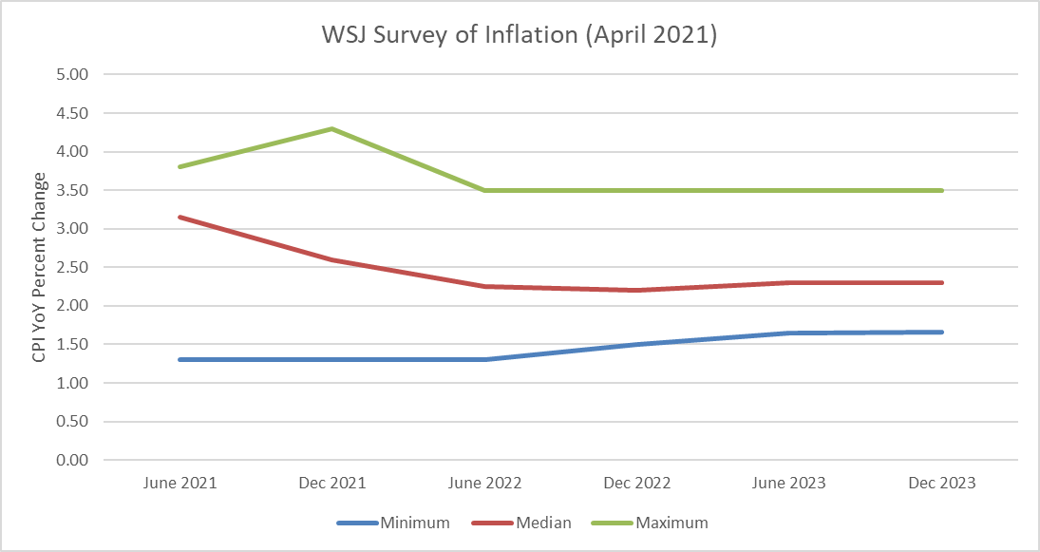
Will we have inflation or deflation: Survey
This should be the only part of the deck needing updating for V2; the script revisiosn should not have necessitated additional deck revisions
Survey says: moderate inflation of 2.25% is likely after a transitory spike
This is inline with what the Fed says
Let’s examine how this could happen, how this could be wrong, and most importantly, why is no one forecasting disinflation?
*GDP ≥ pre-recession-levels Confidential – Not for Distribution

Slide 3
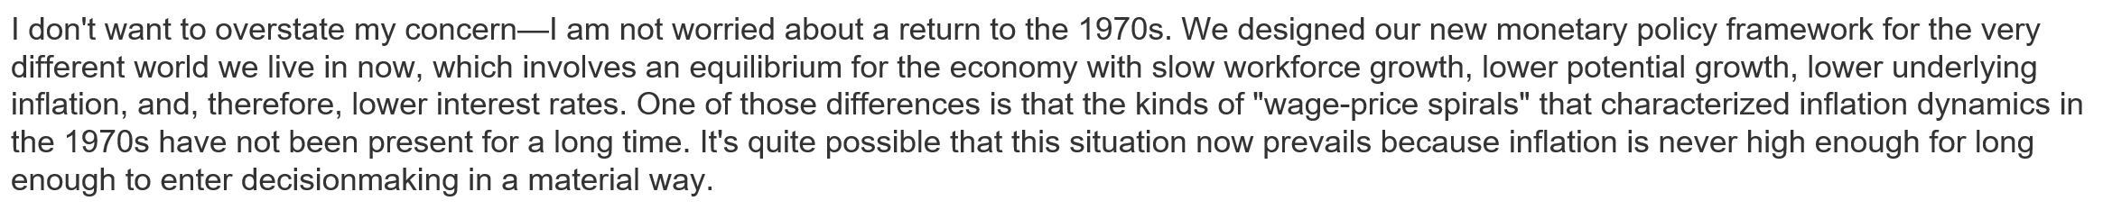
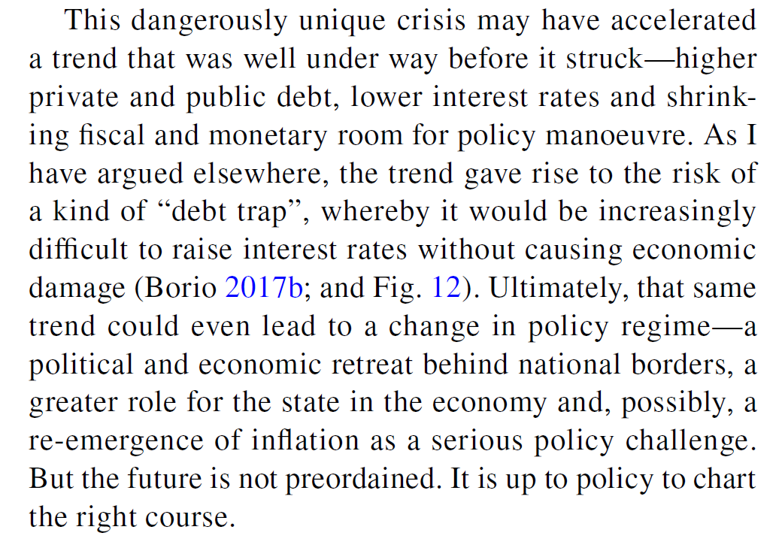
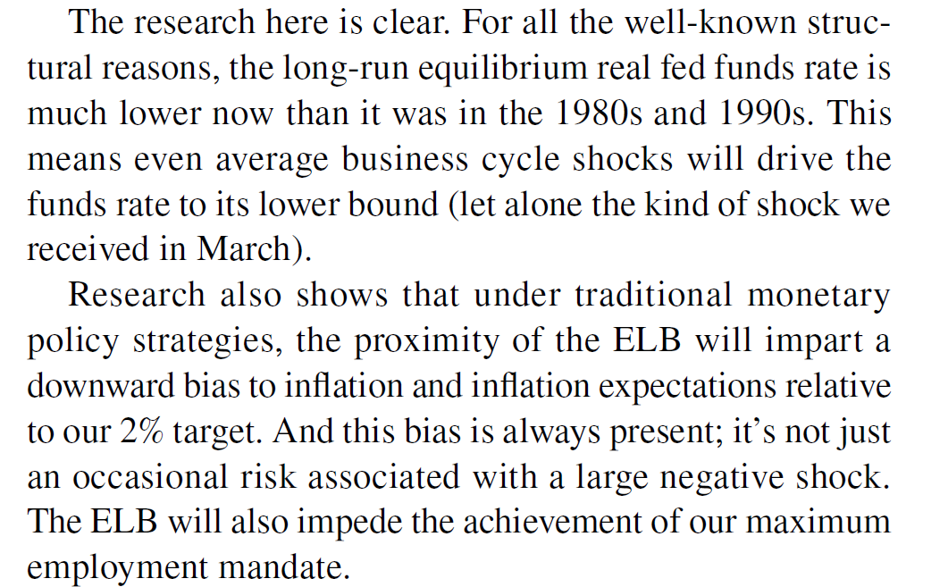
Will we have inflation or deflation: experts
Randal Quarles
Vice Chairman for Supervision
The Federal Reserve System
Claudio Borio,
Head of Monetary and Economic Department,
Bank for International Settlements
Charles L. Evans,
President and Chief Executive Officer
Federal Reserve Bank of Chicago

Slide 4
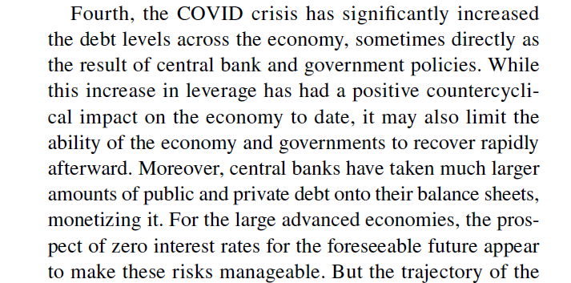
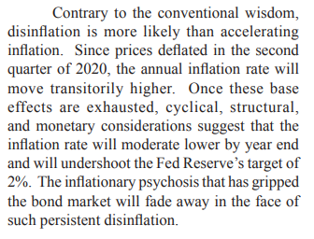
Will we have inflation or deflation: Academics
Patricia C. Mosner, Director, MPA, Economic Policy Management and Senior Research Scholar, Columbia University, SIPA
Dr. Lacy Hunt, former Senior Economist for the Federal Reserve Bank of Dallas

Slide 5
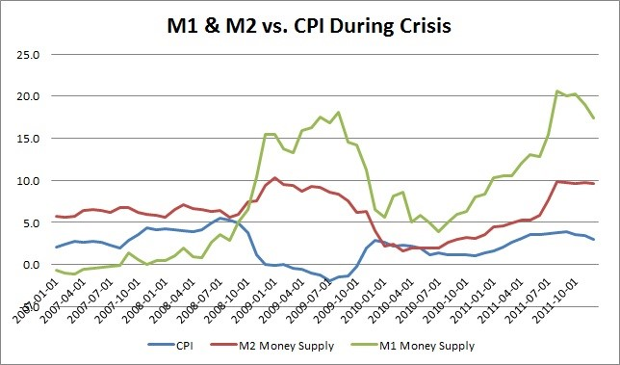
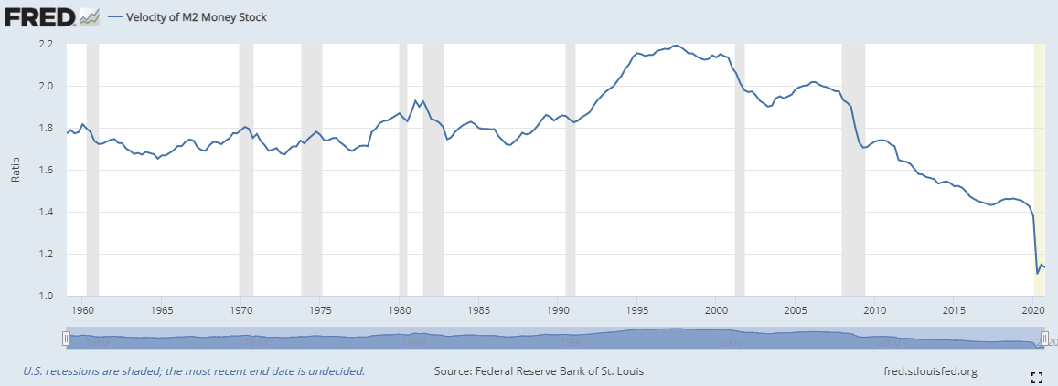
Why would inflation rise?
School 1: because “the Fed is printing money”
1) the Fed doesn’t print money
2) money creation doesn’t alone cause inflation…
3) the spending (multiplier and velocity) does
So will money creation cause inflation? It depends…
*GDP ≥ pre-recession-levels Confidential – Not for Distribution

Slide 6
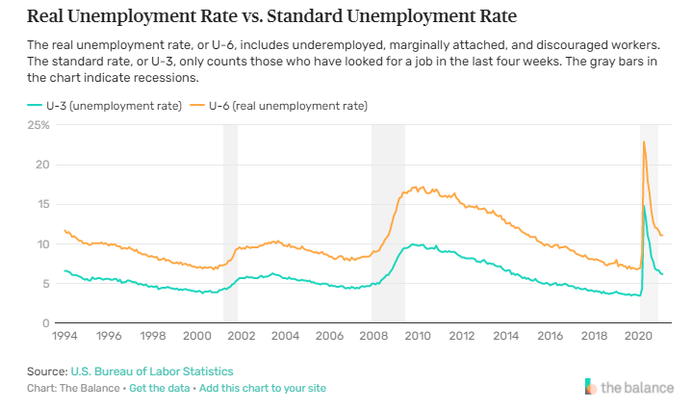
Why would inflation rise?
School 2: because “pent-up demand”
1) What they really mean is “demand-pull inflation” which occurs when the aggregate demand increases beyond the aggregate supply, causing an increase in the price of goods
2) In Keyensian economics this would occur because employment is high, and firms need to hire more/raise wages to keep up with demand. Those higher wages allow for more purchasing
So is employment high? Not really.
*GDP ≥ pre-recession-levels Confidential – Not for Distribution

Slide 7
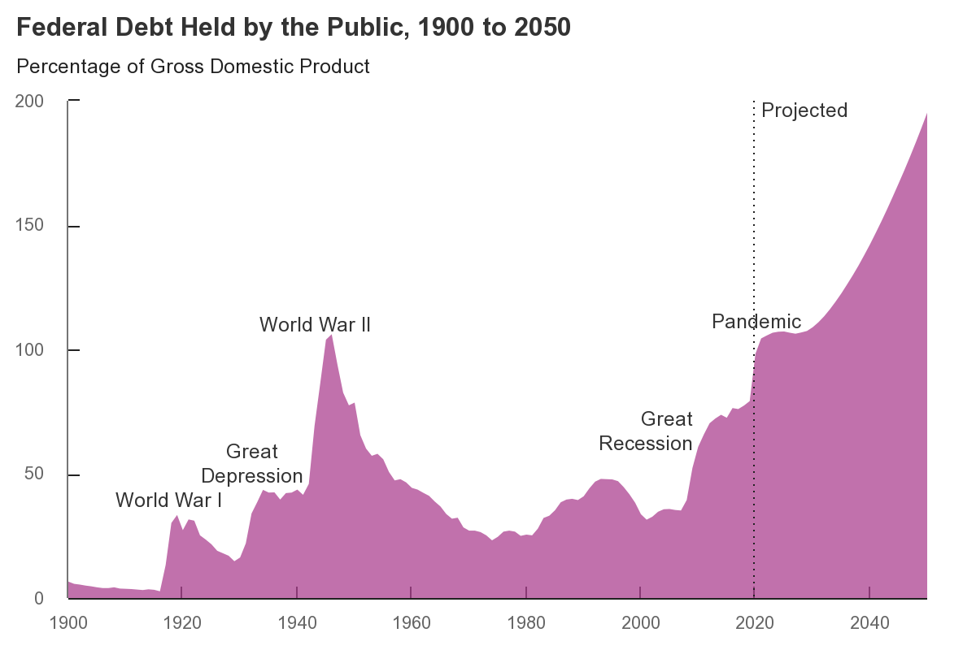
Why would inflation not rise?
Because the economy isn’t as healthy as it was pre-pandemic:
Country is deeply indebted
Nations typically see growth slow when their debt levels reach 90 percent of gross domestic product. The median growth rate falls by 1 percent and average growth falls even more, according to Carmen Reinhart and Kenneth Rogoff writing in Growth in a Time of Debt (NBER Working Paper No. 15639).
Employment is down because whole industries are decimated and women left the workforce in large numbers to care for families
And the bond market is pointing to lower 10-year rates
*GDP ≥ pre-recession-levels Confidential – Not for Distribution

Slide 8
What inflation means for real estate

Slide 9
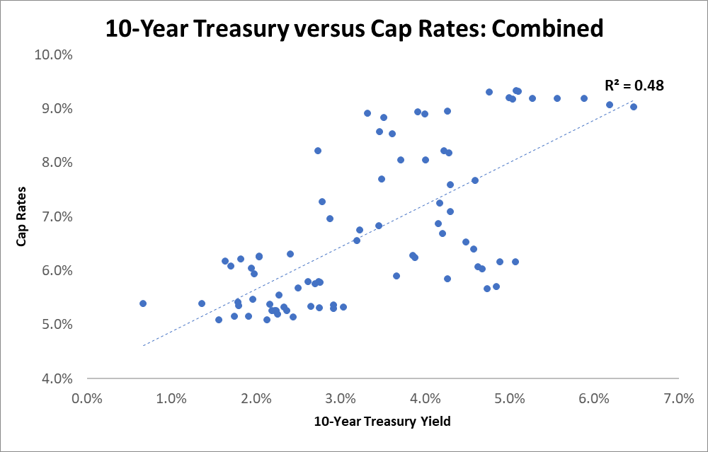
What has real estate done in different rate environments
Some argue CRE is unaffected by interest rates because it can pass through increased prices to tenants
Others argue CRE is negatively affected by greater interest rates because it drives the cap rate up through an increased discount rate.
What does the data show:
*GDP ≥ pre-recession-levels Confidential – Not for Distribution

Slide 10
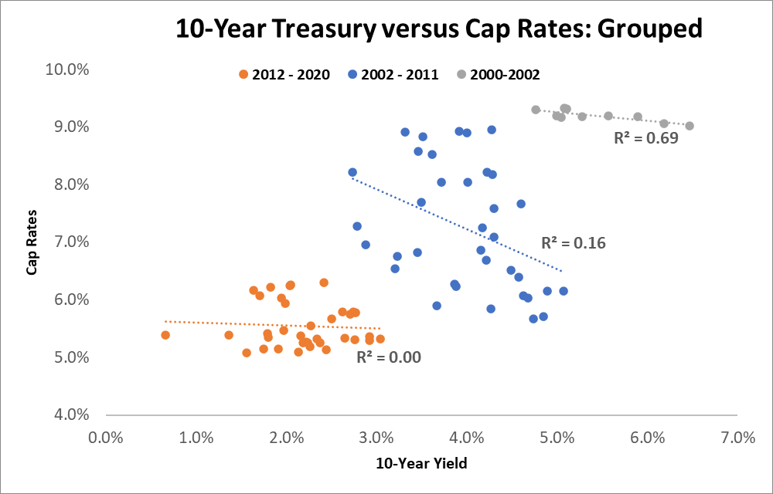
What has real estate done in different rate environments
But is that really the right way to look at it?
What happens if you consider the time component?
*GDP ≥ pre-recession-levels Confidential – Not for Distribution
Notes:
“Combined” should fade away to reveal “Grouped”

Slide 11
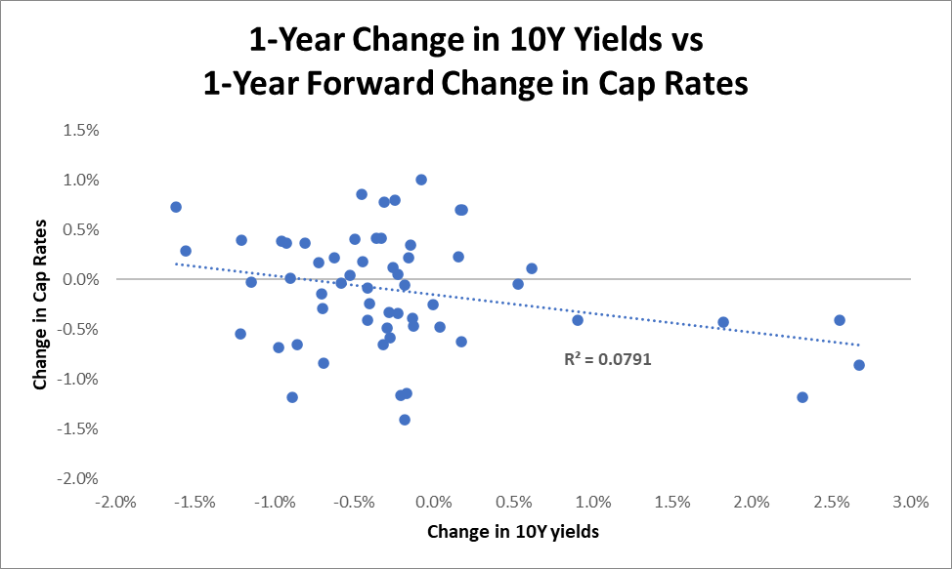
What has real estate done in different rate environments
The more appropriate question (statistically) is, “how do cap rates change in response to a change in rates?”
The answer: very little
*GDP ≥ pre-recession-levels Confidential – Not for Distribution
Notes:
“Combined” should fade away to reveal “Grouped”

Slide 12
What has real estate done in different interest rate environments
Why would real estate perform randomly with regard to interest rate changes?
Because in upward interest rate moves, the cap rate
may go up if inflation is expected to be greater than economic/rent growth (and cash flows need to be discounted at a higher rate)
may go down if economic growth is expected to exceed inflation (and the increased rents can be passed on to tenants)
In downward rate moves, the cap rate
may go up if the economy slows faster than inflation (and the amount tenants can afford to pay does not keep up with inflation; the asset decreases in value)
may go down if inflation slows faster than the economy (and the cash flows need to be discounted at a lower rate)
In both cases, inflation is only half of the answer…
The other half is economic growth
Thus there is only one situation that should lead to cap rate expansion—when inflation outpaces economic growth…we refer to this scenario as
*GDP ≥ pre-recession-levels Confidential – Not for Distribution

Slide 13
Slowflation

Slide 14
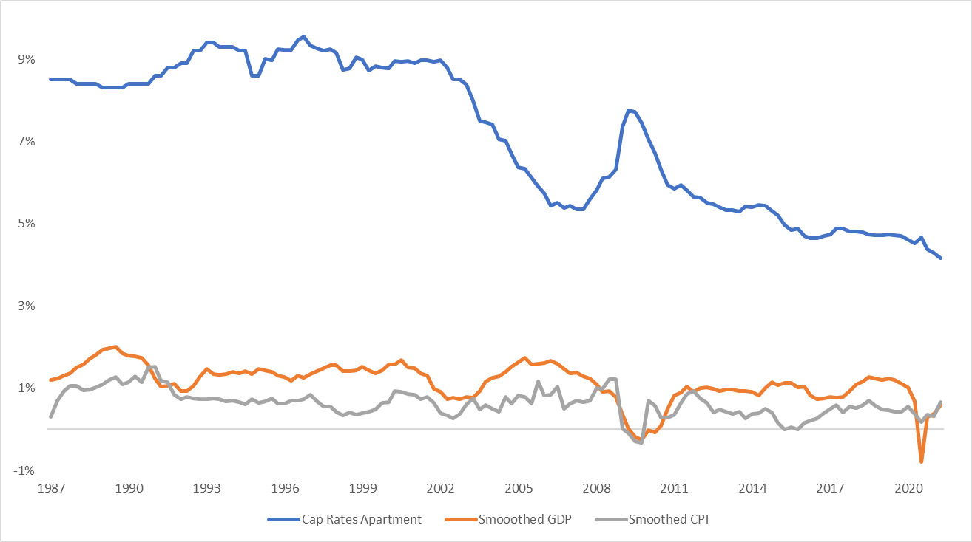
What happens after prices rise and the economy slows?

Slide 15
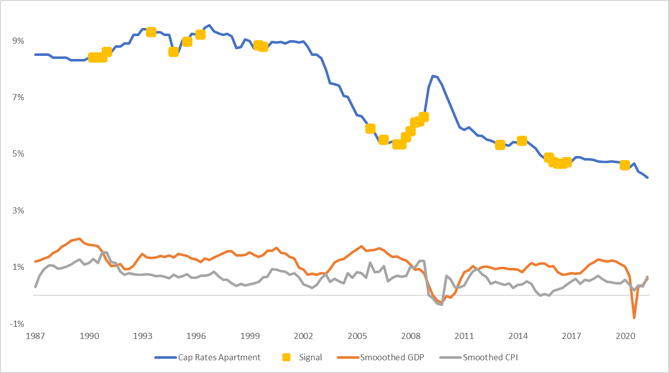
Turning the theory into a signal

Slide 16
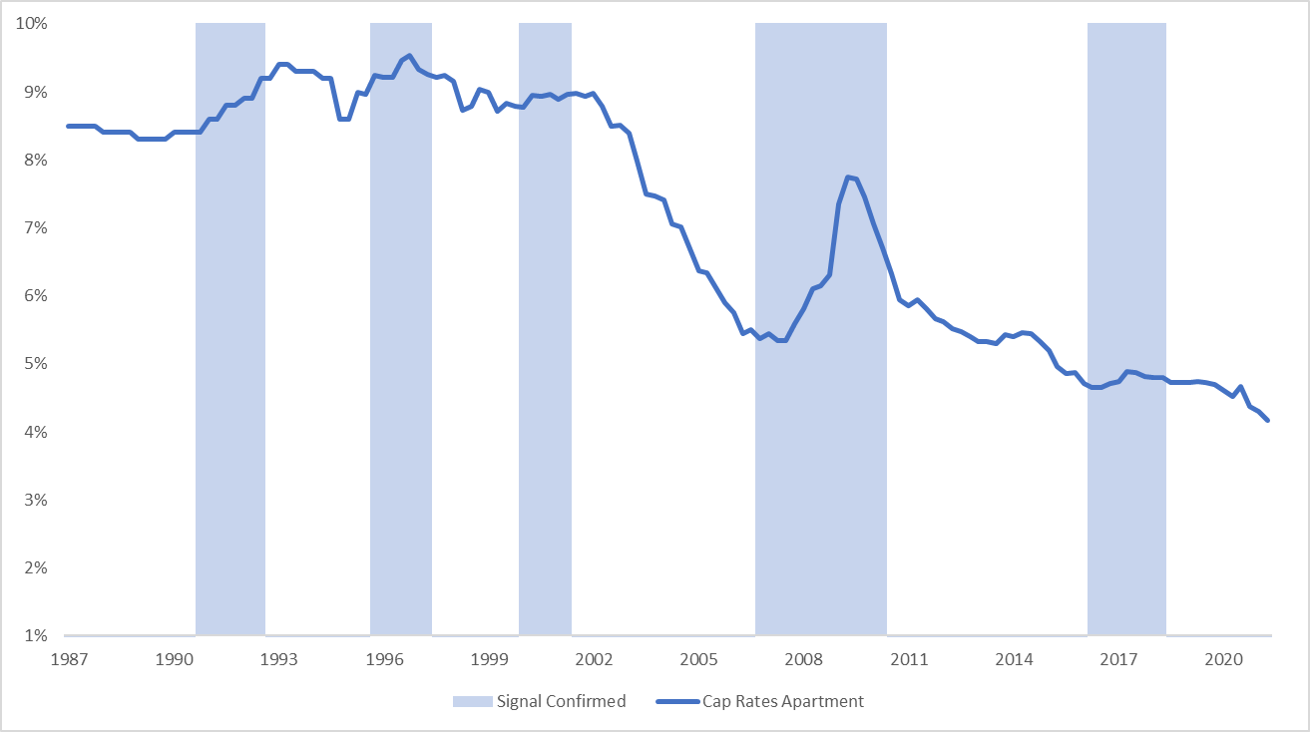
Results: Multifamily

Slide 17
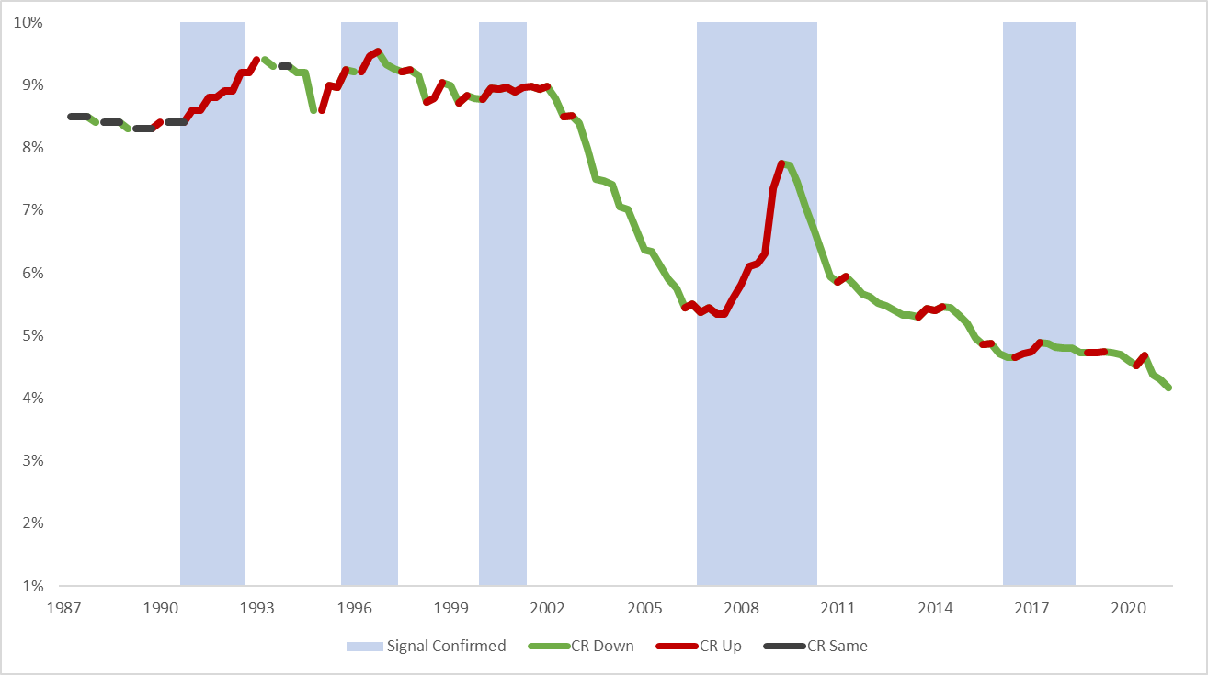
Results: Multifamily

Slide 18
Results: Multifamily
72% of all upward cap rate moves are predicted

Slide 19
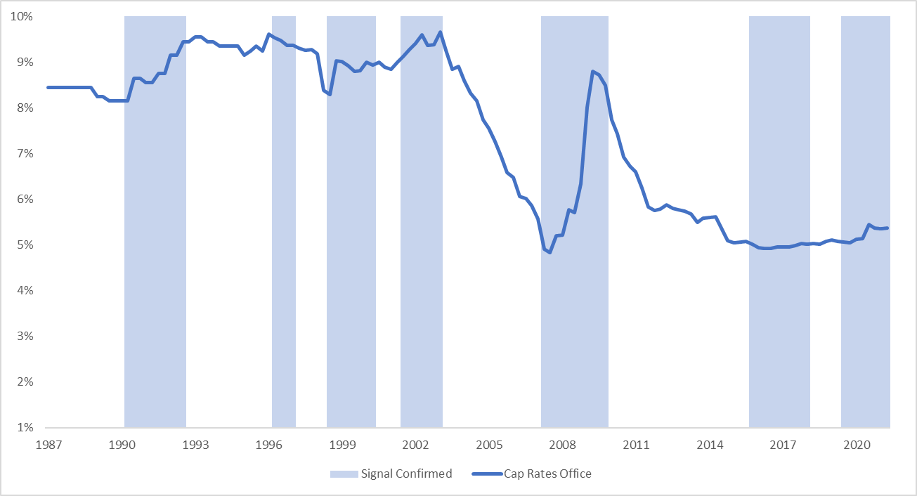
Results: office

Slide 20
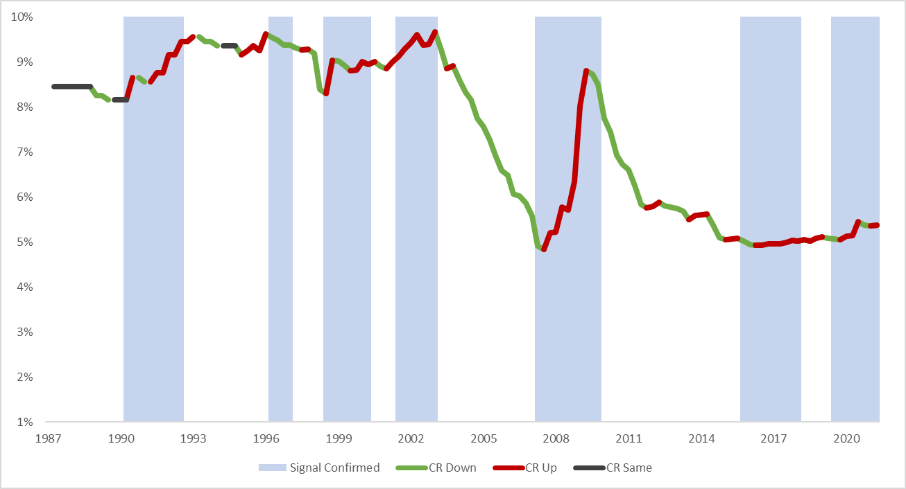
Results: office
85% of all upward cap rate delta is captured

Slide 21
summary
Inflation forecasts from academics, policymakers, and bankers suggest inflation is going to be near 2% with a pull toward the lower side given the debt load.
Though shorter-leased assets have provided more of an inflation hedge than longer-leased assets, there is no consistent relationship between inflation and cap rates because it only captures half of the equation.
The other half of the equation is economic growth, and combined there is one main environment which should lead to cap rate expansion.
That environment is known as slowflation where economic growth is positive but decreasing, and inflationary growth is positive and increasing.
These two factors combine to create a slowflation signal which forecasts cap rate expansion
The signal has performed robustly and currently indicates no cap rate expansion in multifamily and a conclusion of cap rate expansion in office.

